Slide 1


Semester: I/II
CHEMISTRY OF SMART MATERIALS AND DEVICES (Category: Professional Core Course) Stream: CS (Theory and Practice)
Course Code | : | 22CHY12A |  | CIE | : | 100 Marks
Credits: L:T:P | : | 3:0:1 |  | SEE | : | 100 Marks
Total Hours | : | 42L+ 30P |  | SEE Duration | : | 3 Hours
Unit-IV- Smart sensors and devices
C MANJUNATHA, Ph.D, MRSC
Assistant Professor, Department of Chemistry, RV College of Engineering
Bengaluru-560059, INDIA, Phone: +91 9036651277
E-mail: manjunathac@rvce.edu.in; manju.chem20@gmail.com

Slide 2


Unit-IV- Smart sensors and devices
Lecture plan:
Lecture-1: Introduction to smart materials and technology, Internet of things, Internet of nanothings.
Lecture-2: RFID device, meaning, working principle of RFID, classification of RFID tags, (Based on the availability and frequency), Materials for RFID tag (CNT, Graphene, polyaniline)
Lecture-3: Carbon nanotubes (CNTs)-meaning, types, structures; Synthesis by CVD method, functionalization-physical, chemical; properties
Lecture-4: Graphene-meaning, structure of graphene; Synthesis by Modified hummer’s method, functionalization-physical, chemical; properties
Lecture-5: Polyaniline-Synthesis via chemical oxidative polymerization of aniline, different structures of Polyaniline, electronic properties, Applications of CNT, Graphene in logistic information, intelligent packaging systems
Lecture-6: Sensors: Introduction, types of sensors (Piezoelectric and electrochemical)
Lecture-7: Strain sensors- working principle, nanomaterials used, applications
Lecture-8: Electrochemical Sensors- working principle, types of electrodes, significance of each electrode, sensing mechanism.
Lecture-9: Applications of Electrochemical sensor for biomolecules-Glucose-Diabetic management, Vitamin-C (Ascorbic acid) Electrochemical-VOCs, and Gas sensor

Slide 3

The Internet of Things (IoT)
It is the network of physical objects—“things”—that are embedded with sensors, software, and other technologies for the purpose of connecting and exchanging data with other devices and systems over the internet.

Slide 4
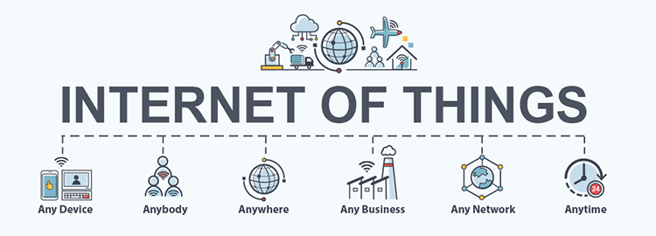

Slide 5
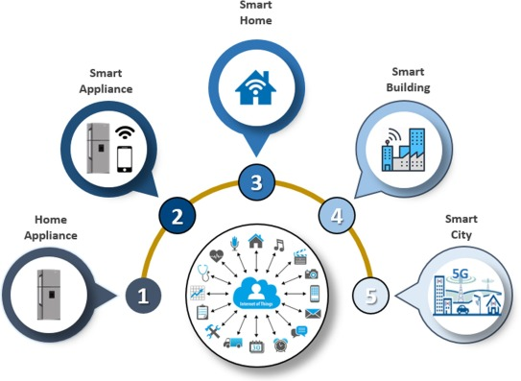
Applications of The Internet of Things (IoT)

Slide 6


Slide 7
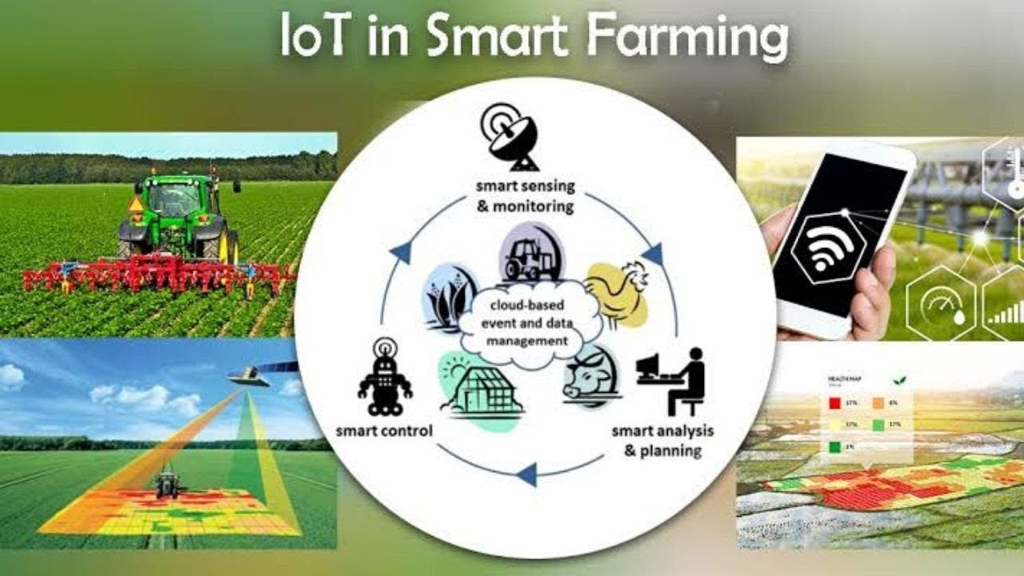

Slide 8


Slide 9


Slide 10



Slide 11
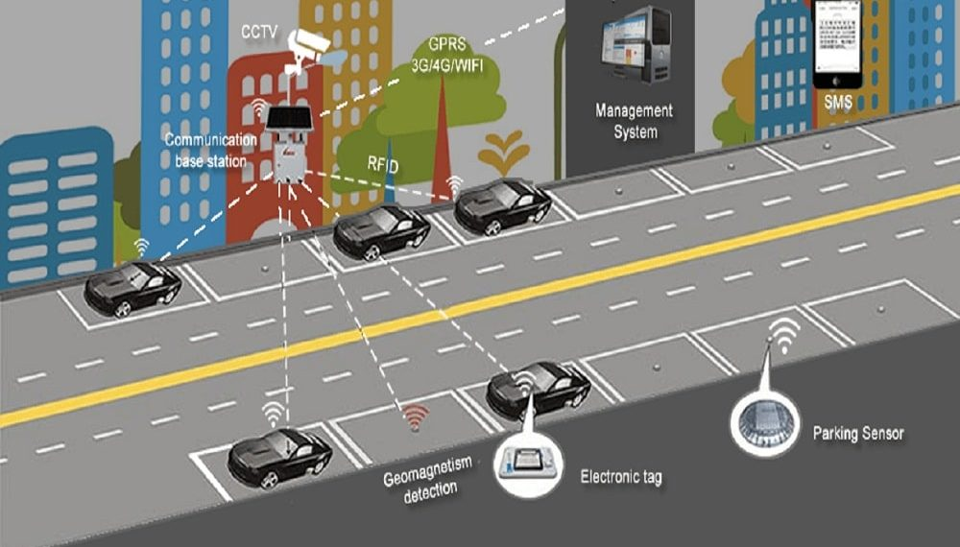

Slide 12
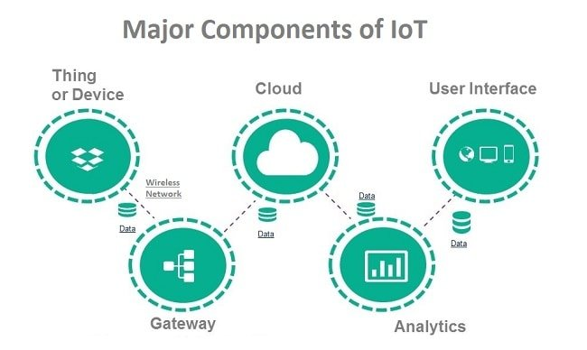

Slide 13
1. Things/Devices and sensors are the components of the device connectivity layer. These smart sensors are continuously collecting data from the environment and transmit the information to the next layer.
Common sensors are: Temperature sensors and thermostats, Pressure sensors, Humidity / Moisture level
Light intensity detectors, Moisture sensors, Proximity detection, RFID tags
smart devices and sensors can be connected to low power wireless networks like Wi-Fi, ZigBee, Bluetooth, Z-wave, LoRAWAN
2. IoT Gateway manages the bidirectional data traffic between different networks and protocols. Gateways can be configured to perform pre-processing of the collected data from thousands of sensors locally before transmitting it to the next stage
3. Cloud : Internet of things creates massive data from devices, applications and users which has to be managed in an efficient way. IoT cloud offers tools to collect, process, manage and store huge amount of data in real time. Cloud system integrates billions of devices, sensors, gateways, protocols, data storage and provides predictive analytics.
4. Analytics is the process of converting analog data from billions of smart devices and sensors into useful insights which can be interpreted and used for detailed analysis.
5. User interfaces are the visible, tangible part of the IoT system which can be accessible by users.

Slide 14
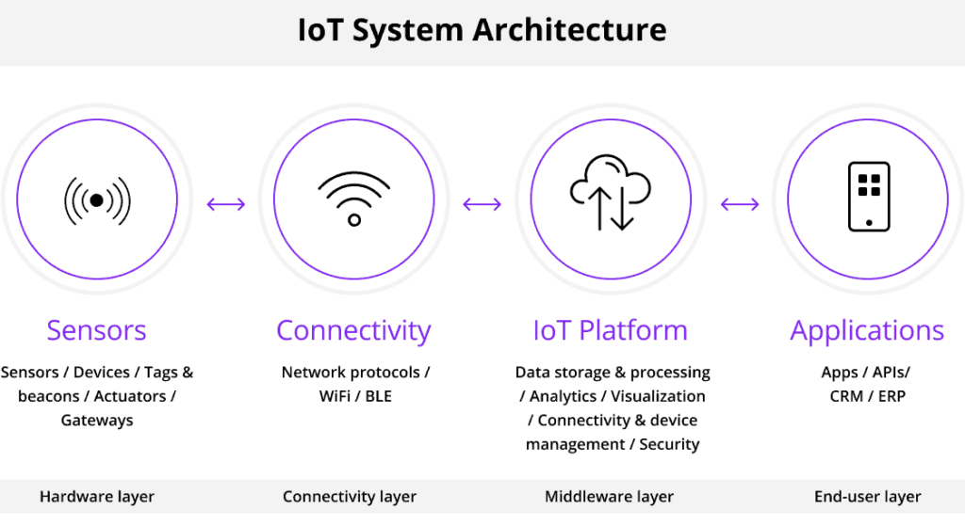

Slide 15
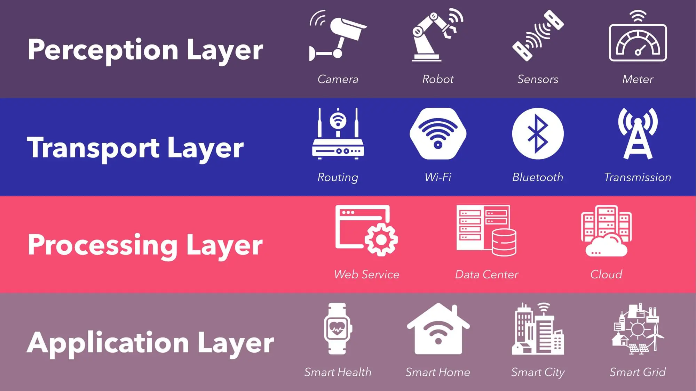

Slide 16
The Internet of Nano Things (IoNTs)
The Internet of Nano things is nothing but the interconnection of nano devices with existing networks. Thus, it creates a state of the art revolution in electromagnetic communication areas among nano scale devices.

Slide 17
RFID technology
It widely used in many fields from tracking cattle in smart agriculture to counting items during warehouse inventory.
Retail, manufacturing, logistics, smart warehousing and banking are among the major industries using
RFID Internet of Things (IOT) solutions.

Slide 18


Slide 19
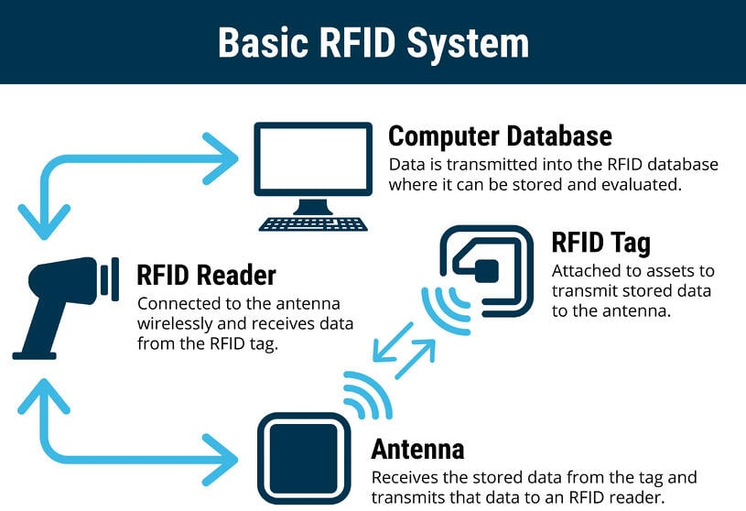

Slide 20
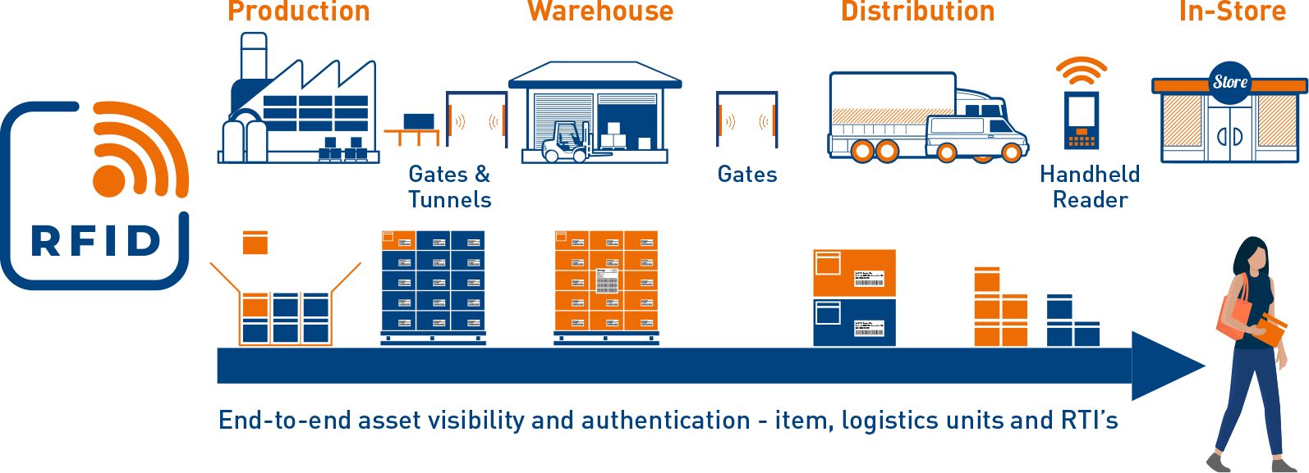
RFID in logistic information, intelligent packaging systems

Slide 21

RFID based supermarket shopping system

Slide 22

RFID based shopping system

Slide 23

RFID based METRO shopping system

Slide 24

RFID Tags

Slide 25



Slide 26
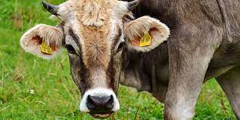
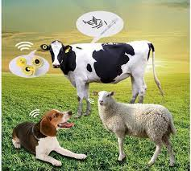


Slide 27
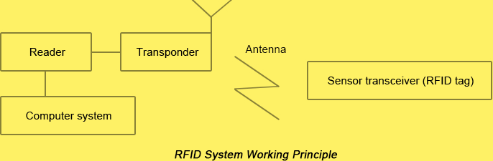
RFID: It is a wireless, an electronic device/tag, which uses electromagnetic field to identify, track and connect with the objects attached with tags

Slide 28
RFID working principle
The RFID system consists of RFID TAG, ANTENNA, TRANSPONDER, READER, COMPUTER
RF signals with a specific frequency are transmitted by READER through ANTENNA.
When ‘RFID TAG’ enters the ‘READER’ area, the ANTENNA will transmit induced current, which activates the ‘RFID TAG’ to transmits the information to the ‘READER’. (Passive system)
In case of active system, when the RFID TAG enters the READER area, the embedded battery powers the RFID TAG in order to complete the communications with each other.
After ‘READER’ reads the self-coded information, it will send the same to ‘COMPUTER’ for exchanging and managing the data.

Slide 29
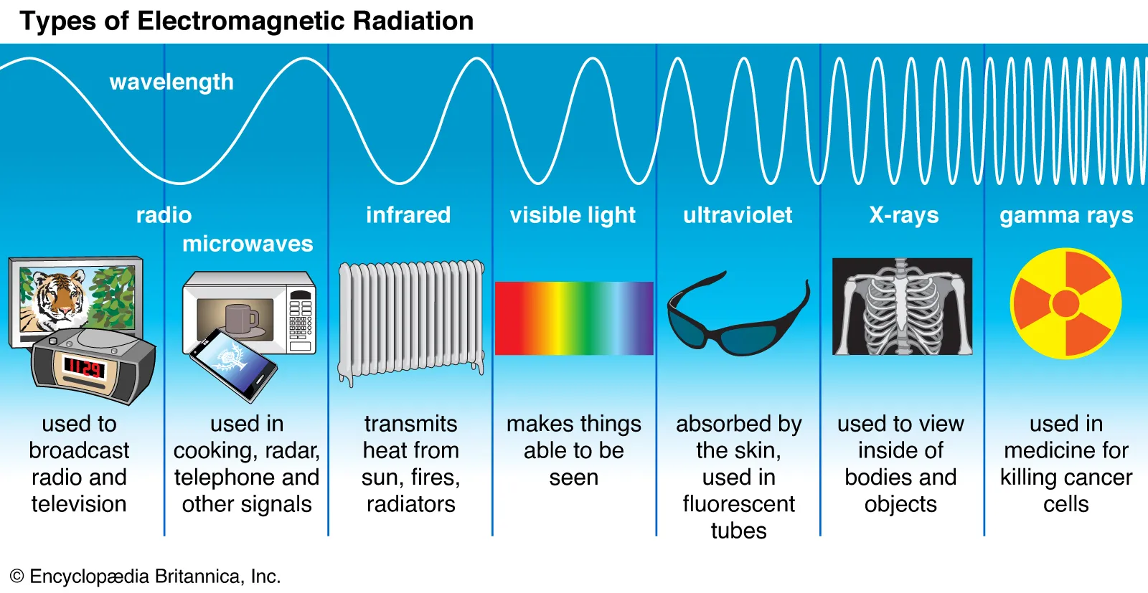

Slide 30
Based on the power requirements, the RFID is classified as follows:
Passive RFID Tag: It is a RFID tag with no inbuilt power source (Battery) designed to use in small range (up to 10 m) tracking systems, operates on low, high or ultra-high frequency. However, it receives power from the reading antenna, whose electromagnetic wave induces a current in the RFID tag's antenna. It is very thin and has a long service life.
Active RFID Tag: It has its own power source, such as battery, inbuilt. It is used for long scanning and reading range (up to 100 m), operates only at high frequency. The price is relatively high, volume is larger than the Passive tag because of the built-in battery.

Slide 31
RFID is classified based on the working frequency range
Types | Low-Frequency | High-Frequency | Ultra High-Frequency
Frequency Range | 100~500 KHz | 10~15 MHz | 850~950 MHz~2.45 GHz
inductive distance | shorter | longer | longest
reading speed | slower | relatively high | fastest
penetration ability | good | Avearge | bad

Slide 32
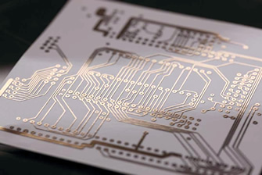
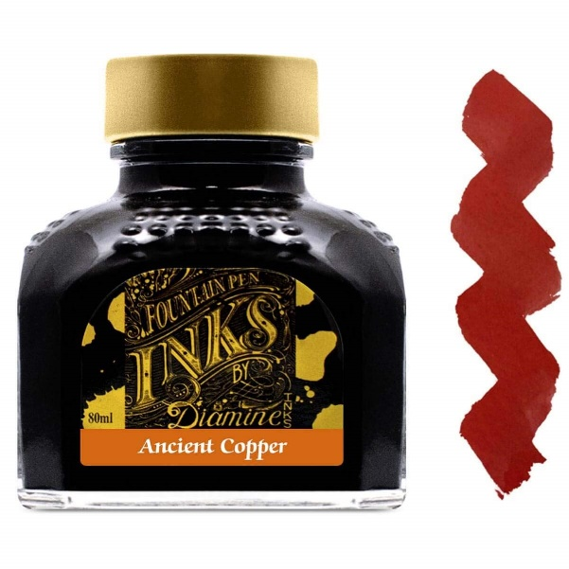
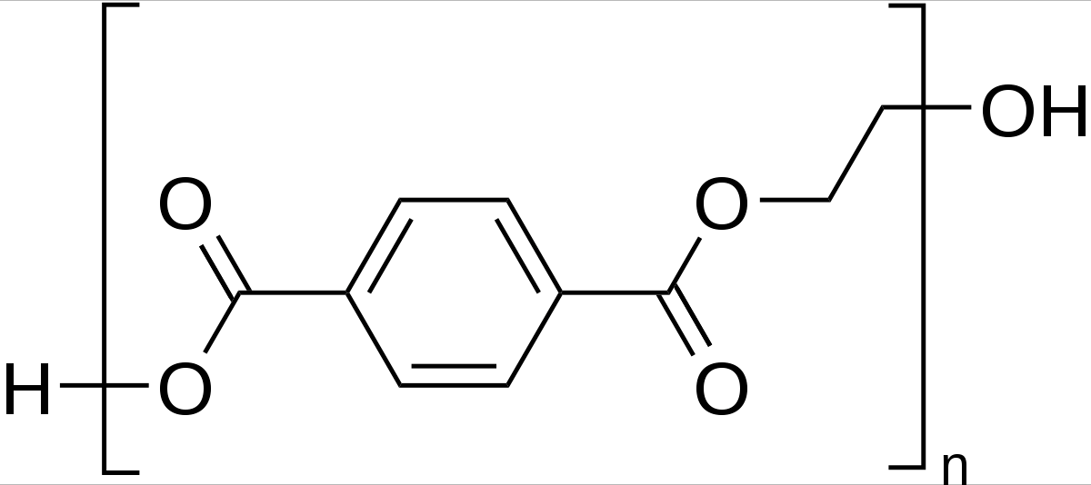
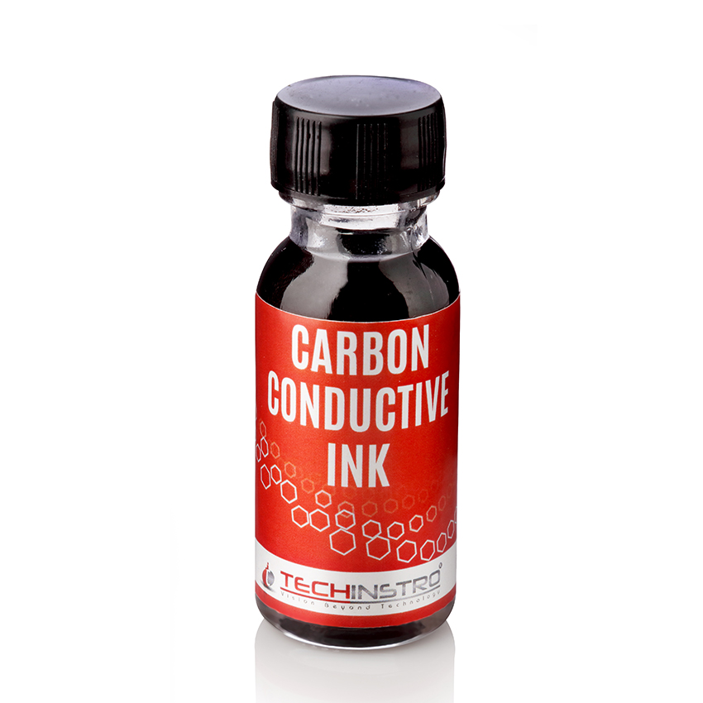
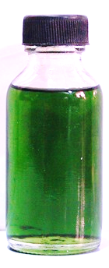
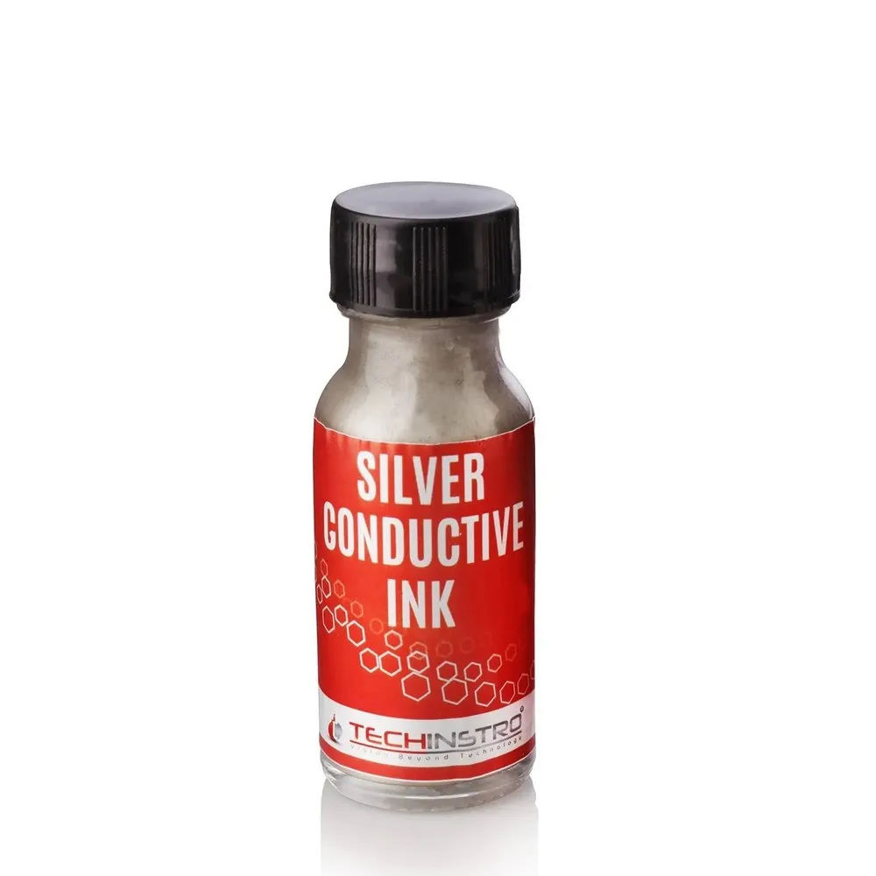
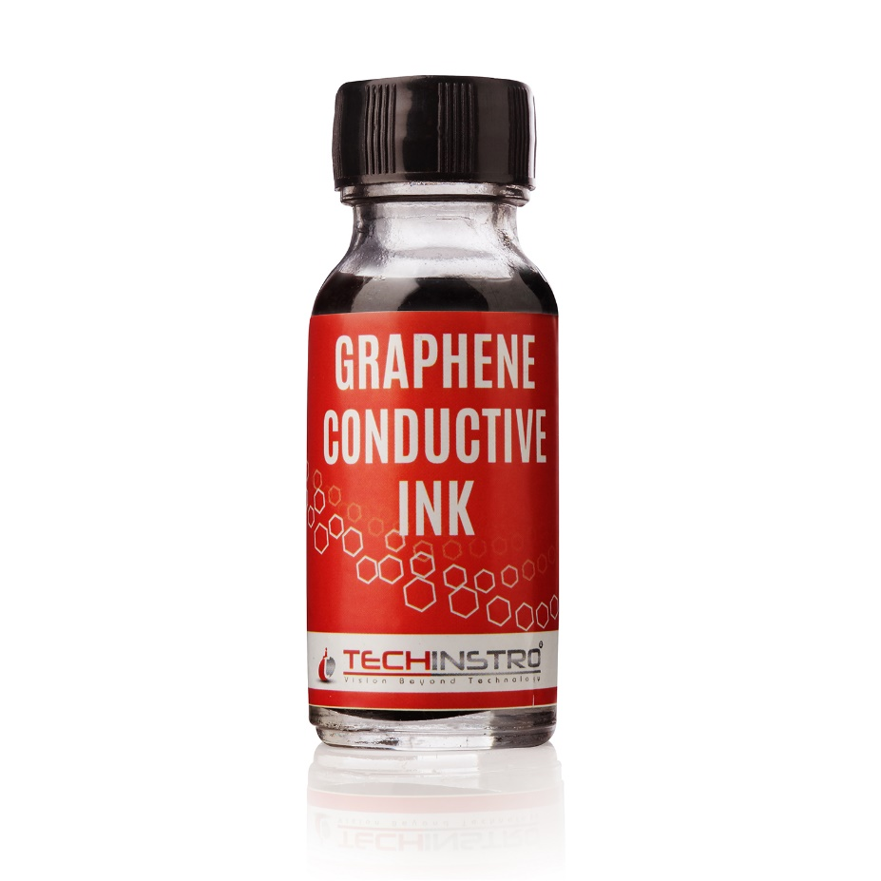

Materials for RFID tag
Polyethylene Terephthalate (PET)
as substrate

Slide 33
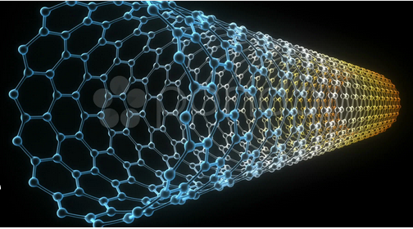
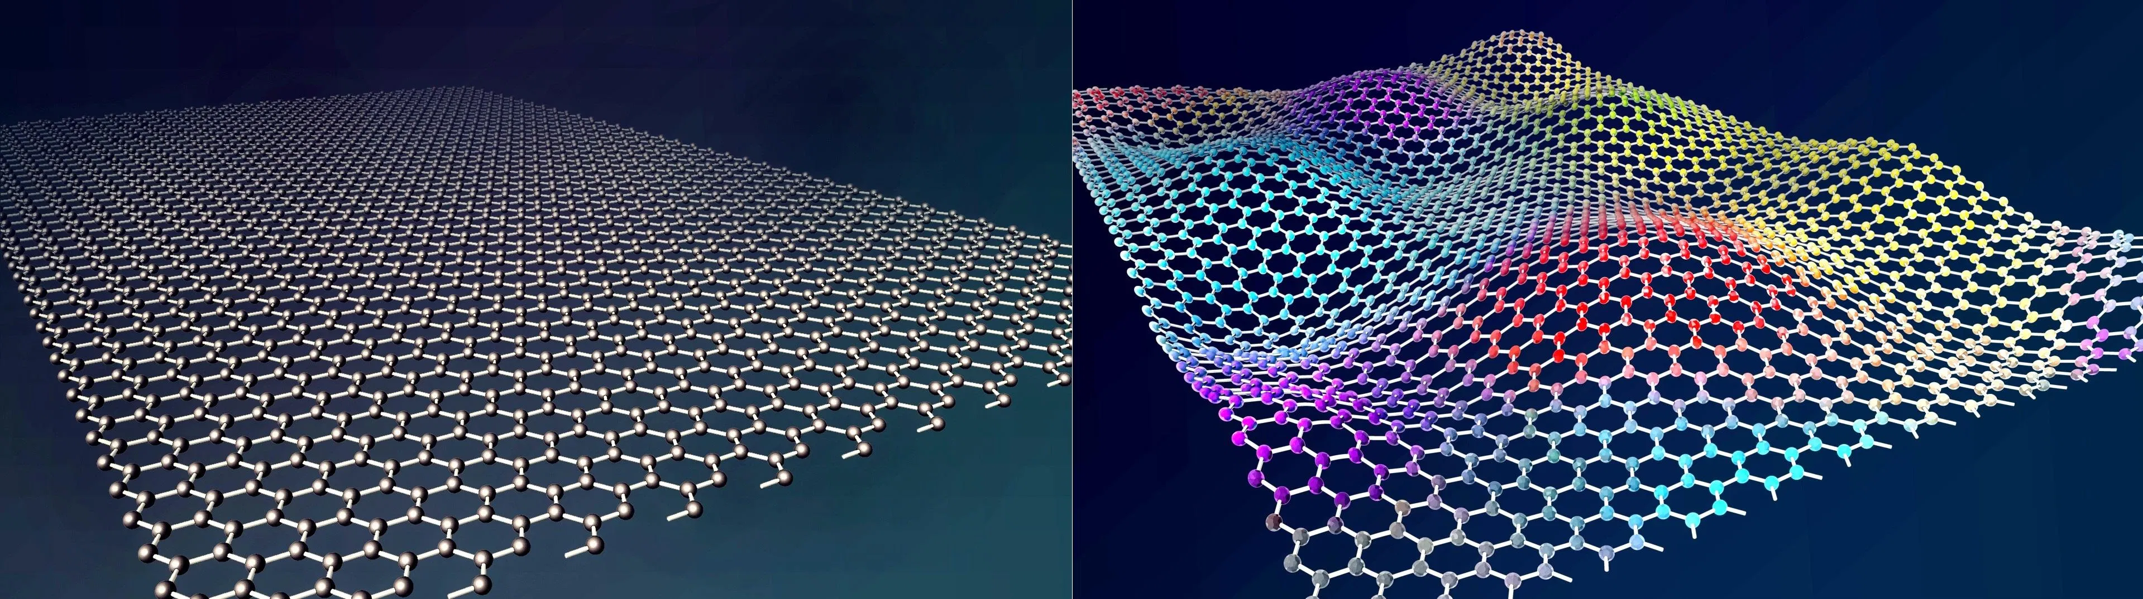
Carbon Nanomaterials
for RFID

Slide 34
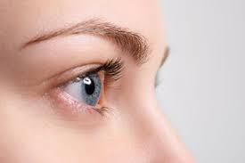
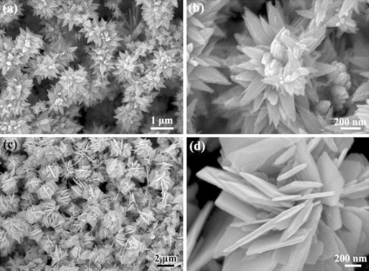
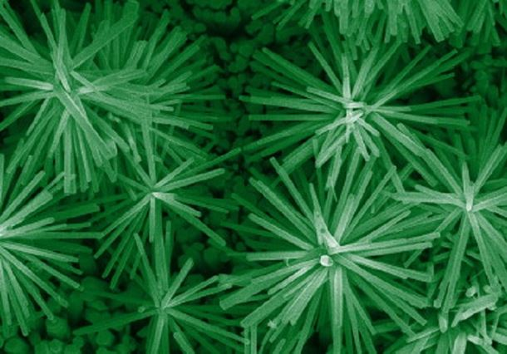
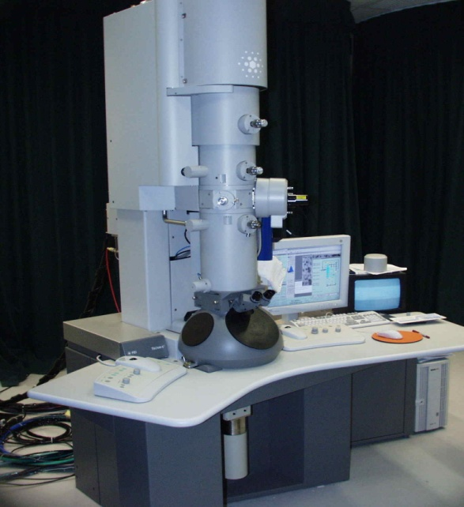
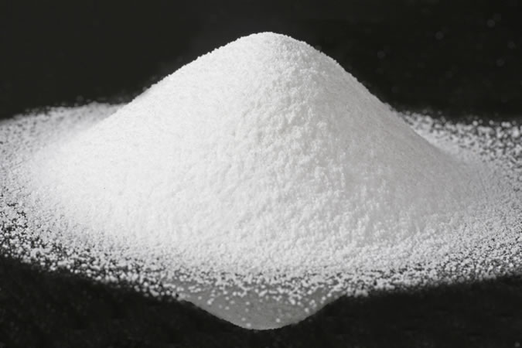

Introduction to Nanomaterials/Science/Technology
Nanomaterials are commonly defined as materials with an average grain size less than 100 nanometers.
The word "nano" originates from the Greek word "nanos" which means "dwarf". However, in scientific language it is a prefix which has a value equal to "one billionth, i.e. 10⁻⁹.
Therefore, one nanometer is one billionth of a meter (1 nm = 10⁻⁹ m).

Slide 35
Nano-dimension comparison
Diameter of a hydrogen atom is about 0.1 nm. If ten hydrogen atoms are aligned in a line, then the resulting length would be approximately 1 nm. Similarly, 1 nm is approximately 5 silicon atoms aligned in a line.
A single strand of human hair is around 20,000 nm in diameter. A nanometer is one millionth of a millimeter - approximately 100,000 times smaller than the diameter of a human hair.
Size of a DNA molecule is about 2.5 nm.

Slide 36
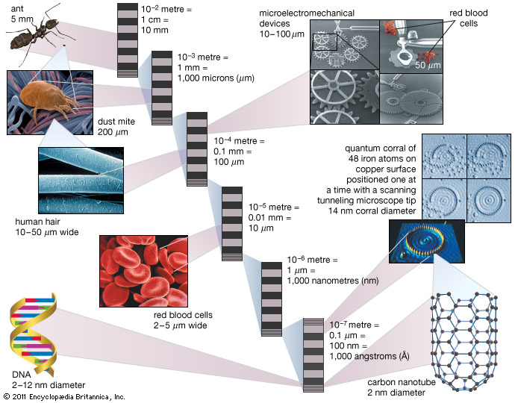
Nano-dimension comparison

Slide 37
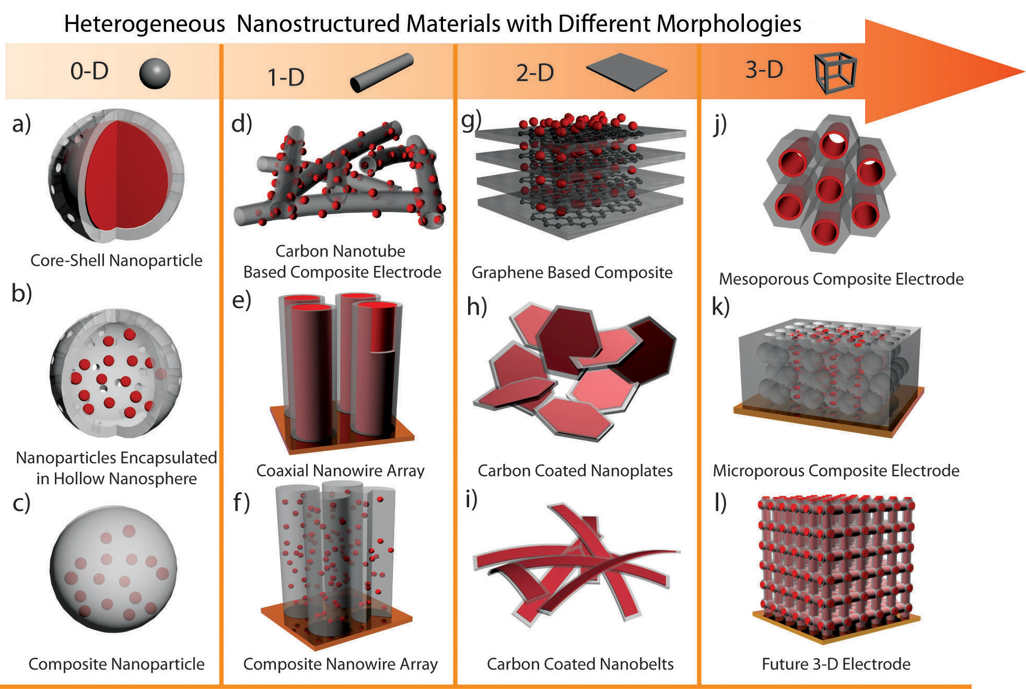

Slide 38
Carbon nanotubes
Carbon is an incredibly versatile element. Depending on how atoms are arranged, it can produce hard diamonds or soft graphite. Carbon materials can exist in various dimensions. The fig below clearly shows the various forms of carbon materials.

Slide 40
Carbon nanotubes
In 1970, Morinobu Endo, First carbon filaments of nanometer dimensions was prepared, as part of his PhD studies at the University of Orleans in France. He grew carbon fibers about 7 nm in diameter using a vapor-growth technique. Filaments were not recognized as nanotubes and were not studied.
In 1991, while experimenting on fullerene and looking into soot residues Sumio LIJIMA invented two types of nanotubes namely single walled carbon nanotubes (SWNTs) and multi walled carbon nanotubes (MWNTs). SWNT consists only of a single graphene sheet with one atomic layer in thickness, while MWNT is formed from 2 to several tens of graphene sheets arranged concentrically into tube structures.
Definition:
Carbon nanotubes are a new form of a hexagonal network of carbon atoms rolled up in the form of cylindrical shape.

Slide 41

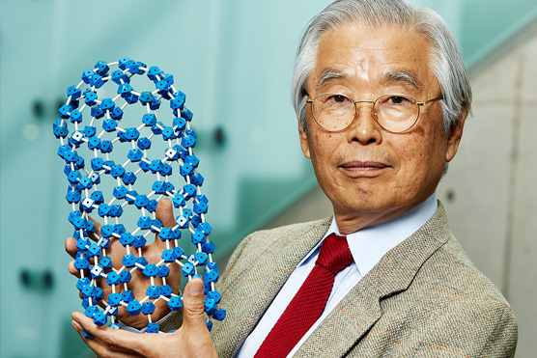

Slide 42
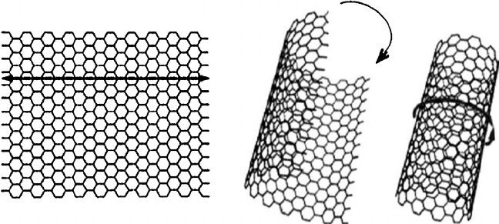
Graphene and Carbon nanotubes

Slide 43
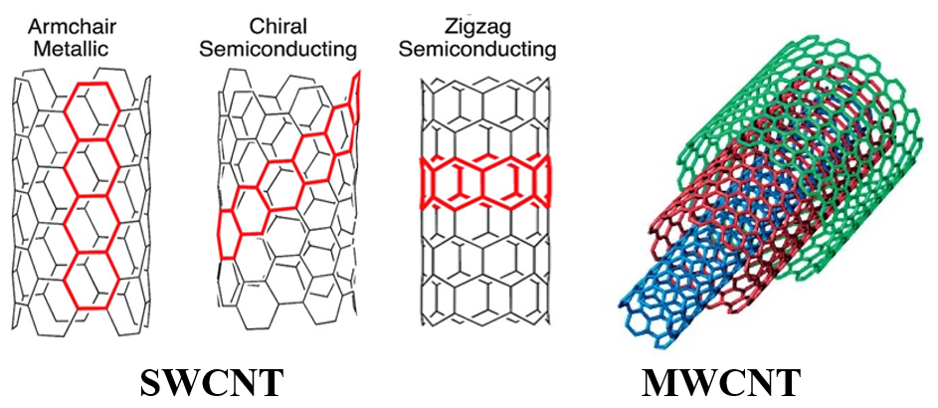
Different forms : (Types of CNTs)
1) Single-Wall Nanotube (SWNT) (a. Arm Chair, b.Chiral c.Zig-Zag )
2) Multi-Walled Nanotubes (MWNT) Multiple rolled layers of graphene sheets, More resistant to chemical changes than SWNTs

Slide 44
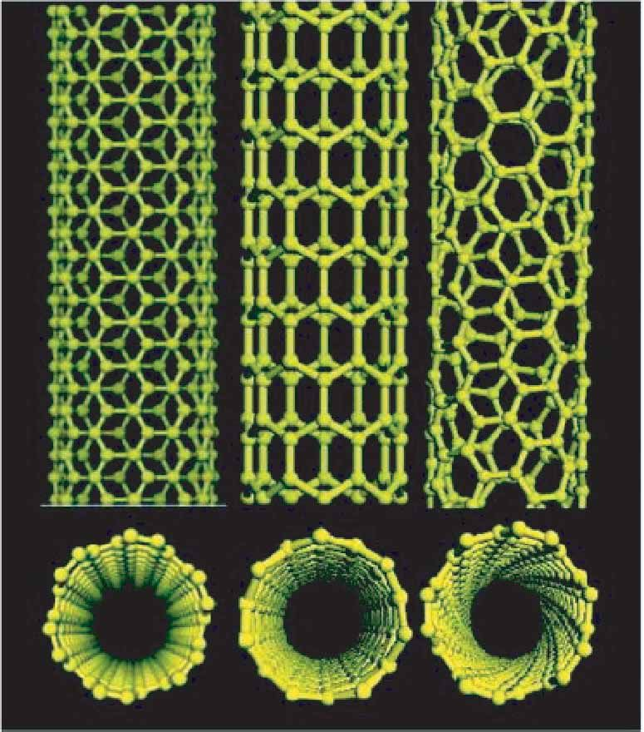
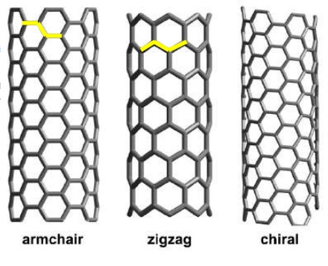

Slide 45
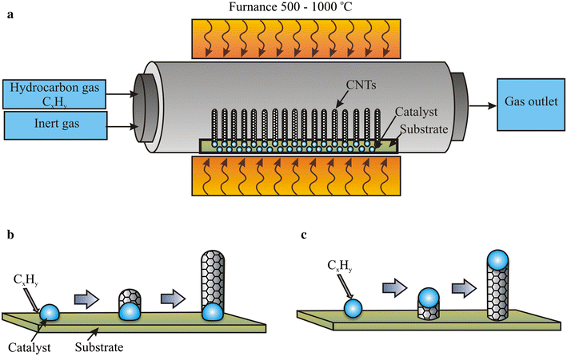
Synthesis of CNTs by modified CVD method:
Chemical Vapor Deposition: Requirements:
High Temperature Tubular furnace (500 to 1500 ℃)
Source of Carbon: Methane, ethylene, hydrocarbon gas, xylene, natural gas
Substrate: carbon, quartz, silicon
Inert gas: Argon, Hydrogen, Nitrogen
Catalyst: Ferrocene, Nickellocene, Cobaltocene
Zaytseva, O., Neumann, G. Carbon nanomaterials: production, impact on plant development, agricultural and environmental applications. Chem. Biol. Technol. Agric. 3, 17 (2016). https://doi.org/10.1186/s40538-016-0070-8

Slide 46
Steps: Procedure involves as follows
The cleaned quartz/carbon/silica substrate is placed in the middle of the tubular furnace.
In order to maintain the inert atmosphere inside the furnace, initially the air/oxygen present inside the tubular furnace has to be removed by passing the argon or nitrogen gas for about 30 min.
After maintain the inert gas atmosphere, the required temperature is set with slow heating rate.
The hydrocarbon precursors in gaseous forms along with ferrocene and Benzene/toluene vapors are pumped into the reaction chamber.
The furnace is heated up to 850–1000 °C and 550–700 °C for SWCNT and MWCNT production respectively.
Initially, at high temperature, due the thermal decomposition of hydrocarbon, carbon atoms are formed are dissolved in the metal nanoparticle catalyst.
Once the threshold concentration of carbon in the catalyst reached, a semi fullerene cap type of structure is formed due to precipitation of carbon atoms. This acts as a seed for further crystal growth, which further continues to grow in tubular form results in to CNT.
After the formation of CNT on catalyst is completed as shown in the above figure, the supply of the reactant/catalyst varpors are stopped.
Then the furnace temperature is reduced slowly to room temperature and supply of the inert gas also stopped.
The CNT formed on catalyst is taken out along with the substrate, subjected to purification.
Zaytseva, O., Neumann, G. Carbon nanomaterials: production, impact on plant development, agricultural and environmental applications. Chem. Biol. Technol. Agric. 3, 17 (2016). https://doi.org/10.1186/s40538-016-0070-8

Slide 47
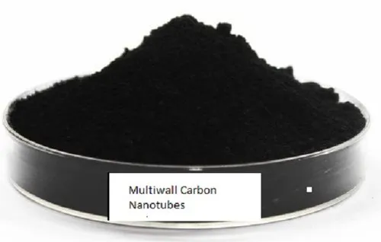
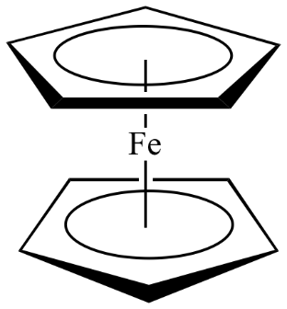

Slide 48
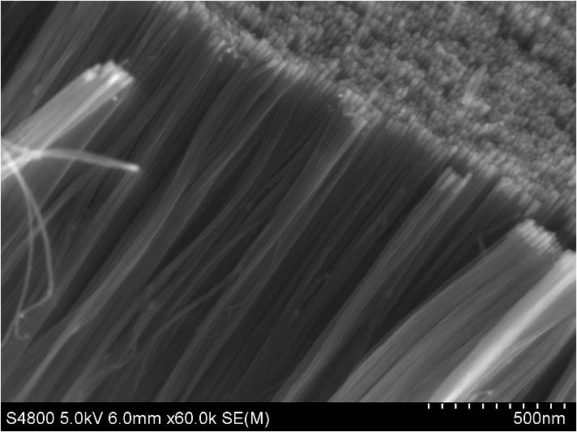
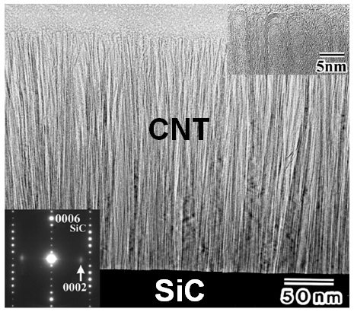
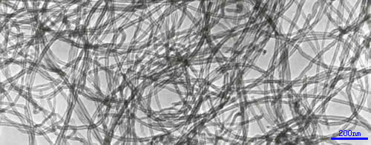

Slide 49
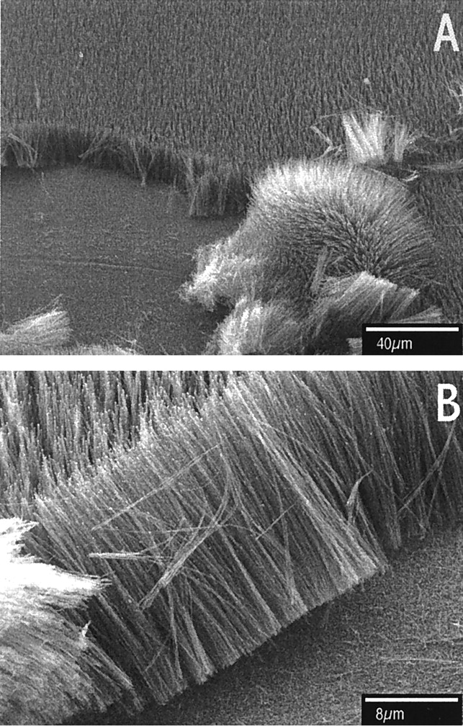
Synthesis of Large Arrays of Well-Aligned Carbon Nanotubes on Glass, Z. F. RenZ. P. HuangJ. W. XuJ. H. WangP. BushM. P. Siegaland P. N. Provencio , Science
6 Nov 1998, Vol 282, Issue 5391
pp. 1105-1107
DOI: 10.1126/science.282.5391.1105

Slide 50
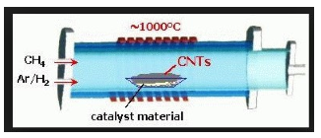
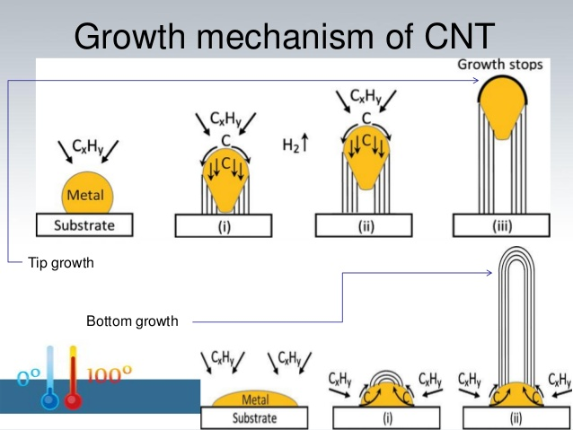
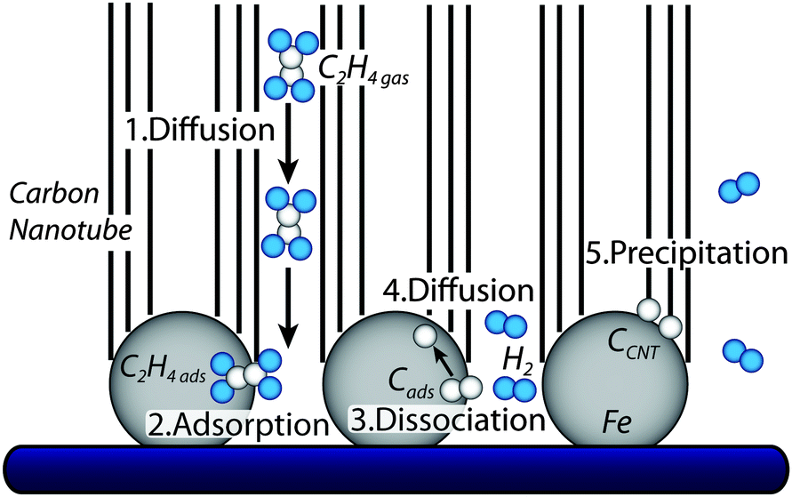
CNT growth mechanism in CVD

Slide 51
Importance of CVD:
The three main parameters for CNT growth in CVD are the atmosphere, carbon source, catalyst, and growth temperature.
Low-temperature (600–900°C) yields MWNTs, whereas a higher temperature (900–1,200°C) reaction favors SWNTs growth.
The most commonly used catalysts for CNT growth are the transition metals (Fe,
Co, Ni) from carbon sources like organometallocenes (ferrocene, cobaltocene, nickelocene), nitrates and others.
A correlation was found between the size of catalyst particles and the nanotube diameter. Hence, metal nanoparticles of controlled size can be used to grow CNTs of controlled diameter.
The CVD method allows CNT growth in a variety of forms, such as powder, thin or thick films, aligned or entangled, straight or coiled, or even a desired architecture of nanotubes at predefined sites on a patterned substrate.
It also offers better control over growth parameters in comparison to other synthesis methods.

Slide 52
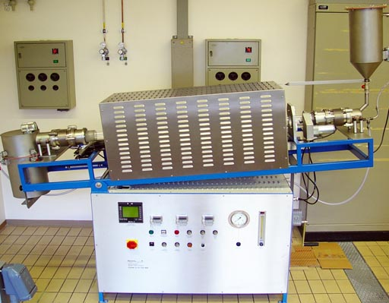
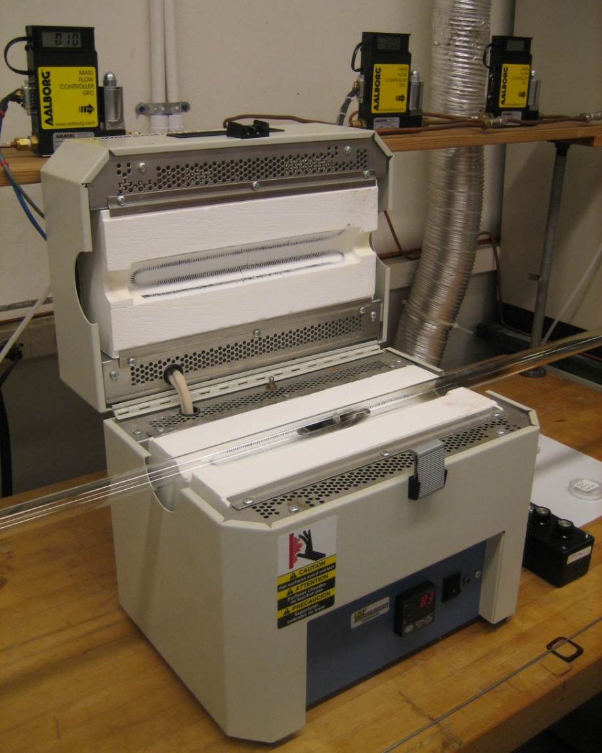

Slide 53
Functionalization of Carbon Nanotubes
Despite CNTs’s exceptional properties, there are two main limitations that hinder its use. The surface energy of CNTs is significantly different from that of matrices such as common organic solvents or polymers and CNTs may not have chemical affinity to the organic matrices and thus, the dispersion of CNTs into matrices is the biggest obstacle in practice.
The modification/ functionalization of CNTs with other materials, makes it the most attractive and ultimate candidate for a many applications which includes nanodevices, to organic electronics. The modification/ functionalization of CNTs can be simply divided into
Chemical (covalent) and b) Physical (noncovalent) functionalization
Chemical functionalization is based on the covalent bond of functional groups onto carbon
form of CNTs. It can be performed at the end caps of nanotubes or at their sidewalls which
have many defects. Direct covalent sidewall functionalization is associated with a change of
hybridization from sp2 to sp3 and a simultaneous loss of p-conjugation system.

Slide 54
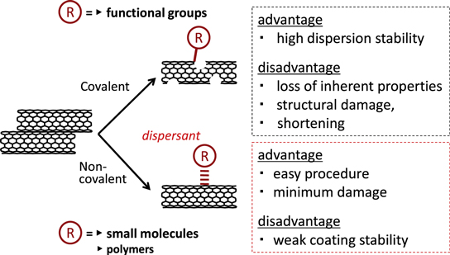

Slide 55
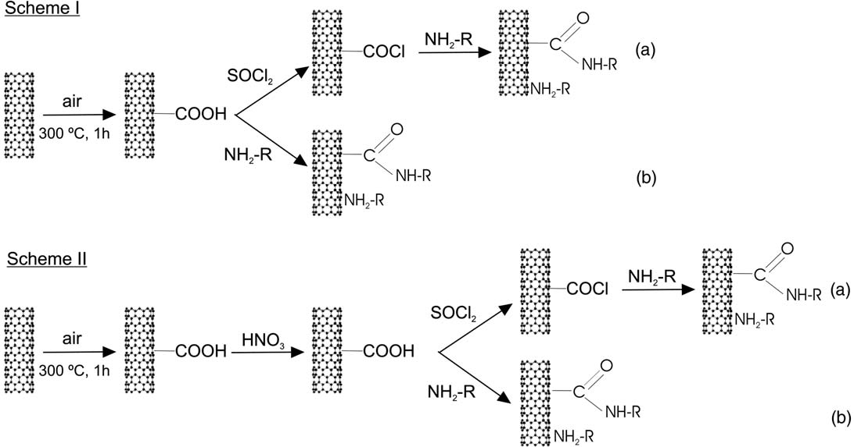

Slide 56
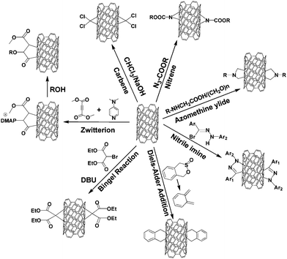

Slide 57
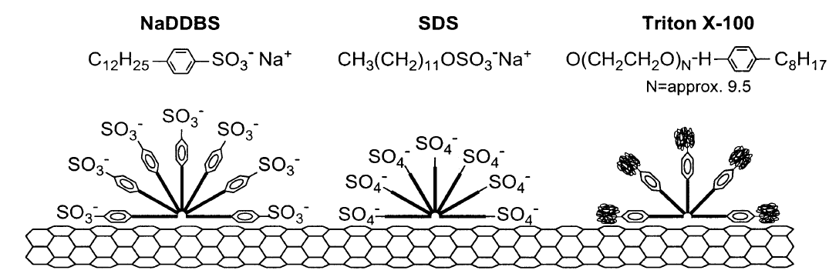
b) Non-covalent functionalization: It does not destroy the conjugated system of the CNTs sidewalls, and therefore it does not affect the final structural properties of the material. The CNTs are functionalized non-covalently by aromatic compounds, surfactants, and polymers, employing π-π stacking or hydrophobic interactions for the most part. In this approaches, the non-covalent modifications of CNTs can do much to preserve their desired properties, while improving their solubilities quite remarkably. (Ex: aromatic small molecule absorption, polymer wrapping, surfactants, biopolymers)

Slide 58
Properties of CNTs:
Carbon-carbon bonds are one of the strongest bond in nature, Composed entirely of sp² bonds
132,000,000:1 Length-To-Diameter Ratio
Diameter of 3 to 9 nm
Lengths in the millimeter range
Extremely high Young’s modulus
Nanotubes can be either electrically conductive or semi conductive, depending on their helicity.
These one-dimensional fibers exhibit electrical conductivity as high as copper, thermal conductivity as high as diamond.
Strength 100 times greater than steel at one sixth the weight, and high strain to failure.
Can act as both thermal conductors and thermal insulators.

Slide 59
Selected electrical and mechanical properties of carbon nanotubes
Properties | CNTs | Other materials
Thermal conductivity (W/mK) | >3000 | Copper= 400 Carbon fiber (pitch)=1000 Carbon fiber (PAN)=8-105
Electrical conductivity (S/m) | 10⁶-10⁷ | Copper=6x10⁶ Carbon fiber (pitch)=2-8.5x10⁶ Carbon fiber (PAN)=6.5-14x10⁶
Young’s modulus (Tpa) | 1-5 | Steel=0.18-0.2 Kevlar=0.06-0.18 Diamond= 0.1-0.12
Tensile strength (Gpa) | 15-150 | Steel=0.38-1.55 Kevlar=3.6-3.8

Slide 60


Slide 61
Applications of CNTs:
Sensor, RFIDs,
Optoelectronic devices (Field Emission Display ( FED))
As electrodes in batteries, capacitors and super capacitor electrodes.
As electrode catalyst supports in Polymer Electrolyte Membrane (PEM) fuel cells
Hydrogen Storage material in hydrogen fuel car.
As electrically powered artificial muscles.
Elctrocatalyst for water splitting, H2 production.
Adsorbent and photocatalyst for organic pollutants degradation.
Sensor for heavy metal ion, gases, volatile organic compounds and biomolecules.
Drug carriers

Slide 62

https://doi.org/10.1088/2399-1984/ab5f20

Slide 63

https://doi.org/10.3390/s18061958

Slide 64


Slide 65
Graphene: The perfect atomic lattice in single sheet.
The carbon nanomaterial having only surface.
Graphene, an excellent electronic material, discovered in 2004 by A. K. Geim and K. S. Novoselov, and received Nobel prize in chemistry for this discovery in 2010.
It has enormous potential in the electronic device community, for example, field-effect transistor, transparent electrode, etc.
Graphene is an allotrope of carbon made of a single layer of carbon atoms that are bonded together in a repeating pattern of hexagons.
It is one million times thinner than paper;
It is also the basic structural element of other allotropes, including charcoal, carbon nanotubes and fullerenes.
Spherical carbon nanomaterials are referred to as fullerenes, while cylindrical ones are called carbon nanotubes.
SWCNT contains one graphene sheet that rolls up to form a cylinder. MWCNT consist of several graphene sheets rolled up together to form concentric cylinders with large annular space at centre.

Slide 66

Synthesis of Graphene Oxide and Reduced Graphene Oxide (rGO)
Modified Hummer’s Method

Slide 67

Synthesis of Graphene Oxide and Reduced Graphene Oxide (rGO)
Modified Hummer’s Method

Slide 68

Stage-I: Synthesis of GO (graphene oxide) from graphite powder

Slide 69

Stage-II: Synthesis of Graphene from GO (graphene oxide)

Slide 70

Functionalisation of Graphene:
Graphene has been functionalized by both covalent and noncovalent means to disperse or
solubilize them in different solvents

Slide 71

Functionalisation of Graphene:
Graphene has been functionalized by both covalent and noncovalent means to disperse or
solubilize them in different solvents

Slide 72





Slide 73


Slide 74


Doping of graphene:

Slide 75


SEM images of Graphene
https://doi.org/10.3390/ma13153271

Slide 76


Applications of Graphene

Slide 77

Applications of Graphene

Slide 78

Applications of Graphene

Slide 79

Applications of Graphene
https://doi.org/10.1021/acsnano.9b00319

Slide 80


Applications of Graphene

Slide 81



Slide 82
Polyaniline
Polyaniline (PANI) that has been extensively used as conducting polymer.
Band gaps in the reduced and oxidized form of polyaniline are 4.3 and 2.7 eV respectively.
Intrinsically conductive polymer used in various applications, including drug delivery, photovoltaic cells, plastic batteries, display devices, microelectronics, chemically modified electrodes, corrosion protection, and polymer light-emitting diode (PLED) displays

Slide 83





APS (oxidant) solution is
added to aniline
solution with
vigorous stirring
at ~0 ℃.
250 ml
beaker
APS (5g) dissolved in
50 ml of 1.0M HCl
Aniline (2ml) dissolved in
50ml of 1.0M HCl
Polyaniline
powder
After the polymerization reaction, the resultant mixture is filtered and washed successively using 1.0M HCl followed by double distilled water, several times until the washings become colorless.
Finally the residue was washed with acetone and dried at 60 ℃.

Slide 84



Polyaniline polymerization reaction
HCl - Catalyst
Polyaniline is synthesized by oxidative polymerization of aniline
Stirring
at ~0 ℃
Oxidant
Quininoid
Benzenoid

Slide 85

Different forms of POLYANILINE
x=0
Completely reduced contains only NH group
x=0.5
Partially oxidised, not neutralised and contains both NH and N group
x=0.5
Partially oxidised, neutralised and contains both NH and N group
x=1
Completely oxidised contains only N group

Slide 86




Chemical polymerization mechanisms of polyaniline.
2019, https://doi.org/10.1021/acs.jmedchem.9b00803

Slide 87

Polyaniline Nanofiber Wrapped Fabric for High Performance Flexible Pressure Sensors
http://dx.doi.org/10.3390/polym11071120

Slide 88

Sensor
It is device that measures change in a physical (heat, light, sound, pressure etc) and/or chemical (pH, smell, taste, concentration, humidity etc) parameters of interest in an environment and transforms it into an electronic signal

Slide 89


Slide 90


Piezoelectric (PE) Sensors
“Piezo” is word derived from Greek, it means for “press” or “squeeze”. A piezoelectric sensor is a device, which converts physical parameters like acceleration, strain, pressure, vibration, temperature, or force into an electrical charge which can then be measured. The schematic representation of PE sensor is shown below.

Slide 91


Slide 92
Characteristics of PE sensors:
The good PE sensor should exhibit:
High strength, High stability,
High voltage output, Highly flexible,
Wide frequency range, Impact resistance,
High mechanical strength,
Elastic compliance etc

Slide 93



Slide 94


Slide 95
Strain Sensor:
Upon applying the external force on an object, the strain (permanent/temporary) is induced in the object due to its structural (internal) deformation, this results in change in internal resistance of the object, which can be measured by using the device called strain sensor. Various nanomaterials like graphene, CNT, PVDF, and their hybrids are used in these sensors.

Slide 96
Strain sensors are widely used in medical industry applications, are as follows:
Pulse measurement – PE sensors are very sensitive to record pulse measurements and effective in monitoring the patients’ health.
Stethoscopes – Due to high sensitivity and robustness PE sensors, they are often used within stethoscopes.
Anaesthesia Effectiveness - PE sensors are capable of accurately measuring the muscles stimulations, and hence can be helpful in understanding the effectiveness of anaesthesia.
Sleep Studies - PE sensors can be attached to various parts of the patient body and can be used to measure the smallest movements of patients during the sleep also.

Slide 97

https://doi.org/10.3390/s18124227

Slide 98

https://doi.org/10.3390/mi9110556

Slide 99
Electrochemical (EC) Sensors:
a device that converts chemical composition data of the analyte into an analytically usable signal.
In electrochemical sensor, the electrode system consist of three electrodes such as working electrode (WE), counterelectrode (CE) and reference electrode (RE).
It has a potentiostat, which is an electronic instrument that controls the voltage between two electrodes.
Working electrode (WE) is very sensitive to any change in analyte solution, provides the surface for the analyte to undergo reaction, when the potential is applied between WE and RE.
The CE helps in completing the circuit by allowing the reaction, which is opposite to WE reaction, to happen. If an oxidation reaction happens at WE, reduction reaction will take place at CE, and vice versa.
The RE is independent of the analyte and other ions concentration. Its potential is constant while measuring the potential of WE. By measuring the current of redox reaction, the analyte can be identified.

Slide 100

Three electrode systems used in electrochemical sensor

Slide 101





Slide 102


Screen printed electrode

Slide 103

Applications of Electrochemical sensor for biomolecules
Glucose sensor in diabetes management
In EC sensor, glucose and oxygen react in the presence of nanomaterials or glucose oxidase (GOx) functionalized WE, and thus oxygen is consumed and hydrogen peroxide is produced (as shown in equation below). Further, the glucose concentration can be detected indirectly by electron transfer of oxygen at CE as shown in reaction.

Slide 104

Ascorbic acid sensor
Ascorbic acid (AA) is also called as Vitamin C, an essential nutrient and antioxidant required for the human body. Unfortunately, the human body cannot produce/synthesize this biomolecule, and hence it should be consumed by food and drugs. The deficiency of AA lead to scurvy, mental disorder, cancer, etc. Similar to glucose, the AA can also be analyzed in EC sensor and the following schematic representation depicts the sensor mechanism of AA.

Slide 105
VOCs sensor
Volatile organic compounds are the organic molecules having very low solubility in water and exhibit a high vapor pressure. They are liberated in industries such as pharma, biotech, paints, vanishes.
Some examples of VOCs are Phosgene, benzene, ethylene glycol, formaldehyde, methylene chloride, tetrachloroethylene, toluene, xylene, acetone, alcohol, and 1,3-butadiene etc. These VOCs are very dangerous to health upon inhaling, which effects to the liver, kidneys, or central nervous system, even some VOCs are suspected or proven carcinogens.
Further, the healthy individual’s exhaled breath has major VOCs such as isoprene (12-580 ppb), acetone (1.2-1,880 ppb), ethanol (13-1,000 ppb), methanol (160-2,000 ppb) and other alcohols. Today, human exhaled breath analysis using gas sensors and e‐noses (as shown below), is helping the diagnosing a wide range of diseases.

Slide 106


Slide 107
Electrochemical Gas sensors
Electrochemical gas sensors also called as electrochemical gas detectors, which are designed to identify and measure the quantity of the concentration of gasses like oxygen, carbon dioxide, carbon monoxide, hydrogen, NOx, SOx, POx, LPG, H₂S etc .
These gases are produced from industrial emissions, vehicle exhaust and open burning of garbage waste, which needs to be monitored.
Therefore the electrochemical gas sensors can be effective tool for analyzing them, as it consumes less power than other conventional gas sensors.

Slide 108

The EC gas sensor system consists of combination of two or three electrodes which are called reference, working, auxiliary/counter electrodes and ionic conductor between them as shown in figure.
In this setup, the ionic conduction of the electrolyte, which in contact with WE and CE, complete the circuit.
When gas molecules (CO) reacted with WE as shown in reaction below,
@WE, CO ​+ ​H₂O → CO₂＋ 2H⁺ + 2e- : The electrons released at WE are made to pass through externally and the H⁺ ion internally towards CE. By measuring the current flow, the type and quantity of gas sensor can be measured.

